Slide 1
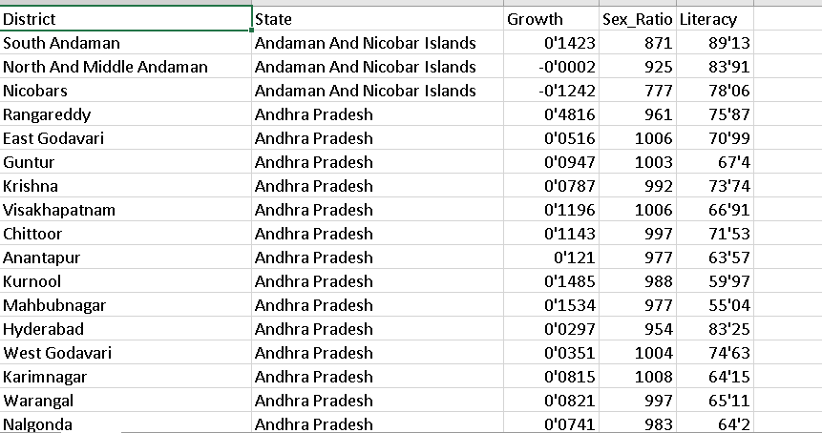
--- data set which include columns -->district , state , growth , sex_ratio , literacy select * from newd..newd1

Slide 2
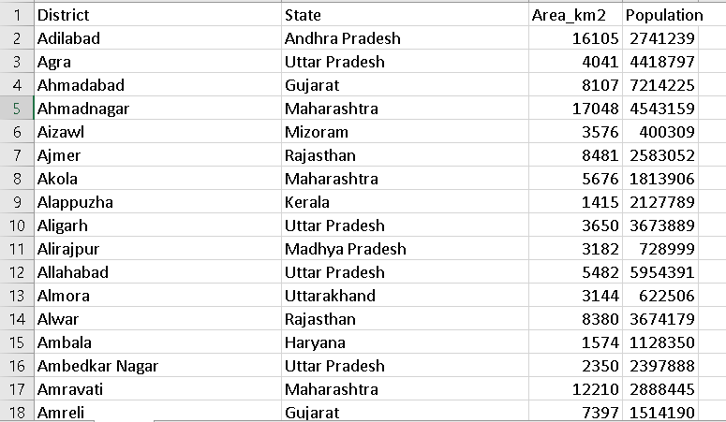
--- data set which include columns -->district , state ,area_km^2, population select * from newd..newd2

Slide 3
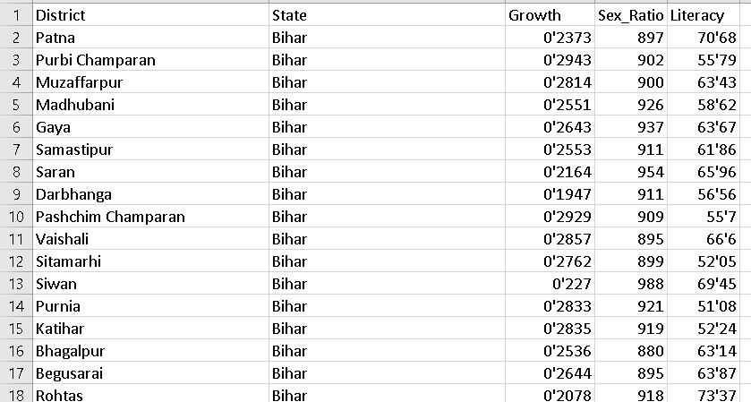
ectracting data for jharkhand and bihar states from dataset select * from newd..newd1 where state in ('Jharkhand' , 'Bihar')

Slide 4
total population of india select sum(Population) as total_population from newd..newd2
total_population
1210854977

Slide 5
what is the average growth percentage of india select avg(Growth)*100 as avg_growth_percentage from newd..newd1
avg_growth_percentage
19'245921875

Slide 6
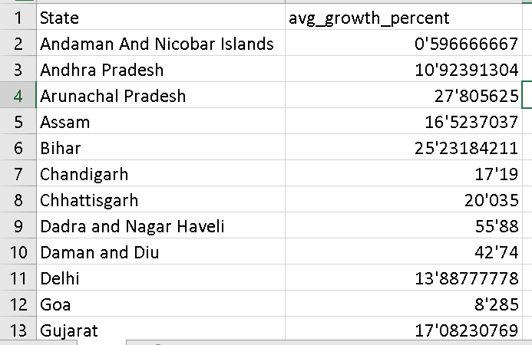
what is the average growth percentage of each state state select State, avg(Growth)*100 as avg_growth_percent from newd..newd1 group by State

Slide 7
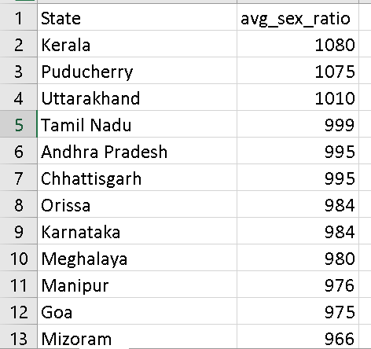
averagesex ratio per state select State,round(avg(Sex_Ratio),0) as avg_sex_ratio from newd..newd1 group by State order by avg_sex_ratio desc

Slide 8
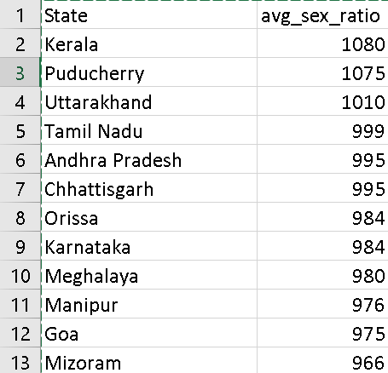
average literacy rate per state select State,round(avg(Literacy),0) as avg_literacy from newd..newd1 group by State order by avg_literacy desc

Slide 9
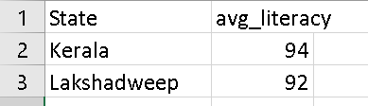
average literacy of states greater than 90 select State,round(avg(Literacy),0) as avg_literacy from newd..newd1 group by State having round(avg(Literacy),0) >90 order by avg_literacy desc

Slide 10

top 3 states showing highest growth ratio select top 3 State, avg(Growth)*100 as avg_growth_percent from newd..newd1 group by State order by avg_growth_percent desc

Slide 11

---bottom 3 states showing highest lowest ratio select top 4 State,round(avg(Sex_Ratio),0) as avg_sex_ratio from newd..newd1 group by State order by avg_sex_ratio asc

Slide 12
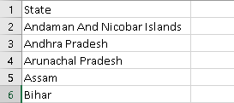
---find the states starting with letter a b select distinct State from newd..newd1 where State like 'a%' or state like 'b%'

Slide 13
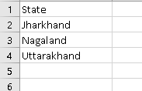
find the states ending with d select distinct State from newd..newd1 where State like '%d'

Slide 14
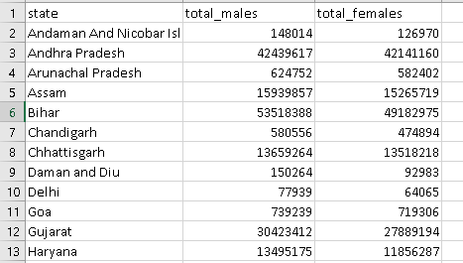
--total males and females select d.state,sum(d.males) total_males,sum(d.females) total_females from (select c.district,c.state state,round(c.population/(c.sex_ratio+1),0) males, round((c.population*c.sex_ratio)/(c.sex_ratio+1),0) females from (select a.district,a.state,a.sex_ratio/1000 sex_ratio,b.population from newd..newd1 a inner join newd..newd2 b on a.district=b.district ) c) d group by d.state;

Slide 15
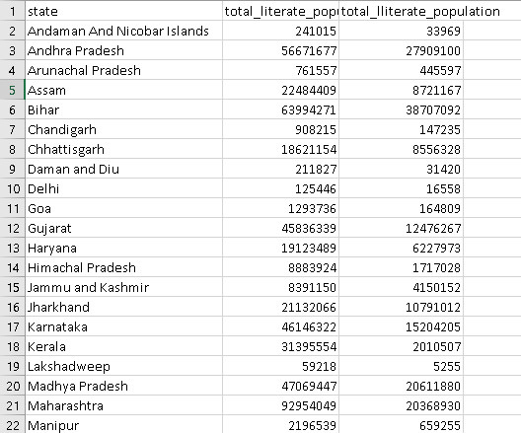
-- total literacy rate select c.state,sum(literate_people) total_literate_population,sum(illiterate_people) total_lliterate_population from (select d.district,d.state,round(d.literacy_ratio*d.population,0) literate_people, round((1-d.literacy_ratio)* d.population,0) illiterate_people from (select a.district,a.state,a.literacy/100 literacy_ratio,b.population from newd..newd1 a inner join newd..newd2 b on a.district=b.district) d) c group by c.state

Slide 16

-- population in previous census select sum(m.previous_census_population) previous_census_population,sum(m.current_census_population) current_census_population from( select e.state,sum(e.previous_census_population) previous_census_population,sum(e.current_census_population) current_census_population from (select d.district,d.state,round(d.population/(1+d.growth),0) previous_census_population,d.population current_census_population from (select a.district,a.state,a.growth growth,b.population from newd..newd1 a inner join newd..newd2 b on a.district=b.district) d) e group by e.state)m

Slide 17

--- reduction of area per population from previous to current census select (j.total_area/j.previous_census_population) as area_reduced_for_prev_census,(j.total_area/j.current_census_population) as area_reduced_for_current_census from (select A.*,S.total_area from ( select '1' as keyy,n.* from (select sum(m.previous_census_population) previous_census_population,sum(m.current_census_population) current_census_population from( select e.state,sum(e.previous_census_population) previous_census_population,sum(e.current_census_population) current_census_population from (select d.district,d.state,round(d.population/(1+d.growth),0) previous_census_population,d.population current_census_population from (select a.district,a.state,a.growth growth,b.population from newd..newd1 a inner join newd..newd2 b on a.district=b.district) d) e group by e.state)m)n) A inner join ( select '1' as keyy,m.* from( select sum(Area_km2) as total_area from newd..newd2) m) S on A.keyy = S.keyy) j

Slide 18
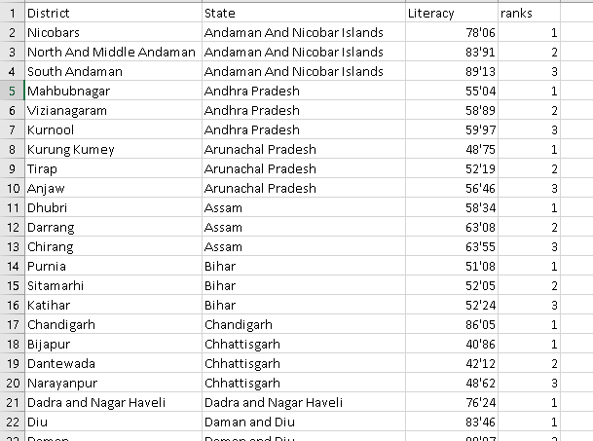
select the top 3 district of each state with highhest literacy rate select sa.* from (select District,State,Literacy,rank() over (partition by State order by Literacy ) as ranks from newd..newd1) sa where ranks in (1,2,3)

